Slide 1
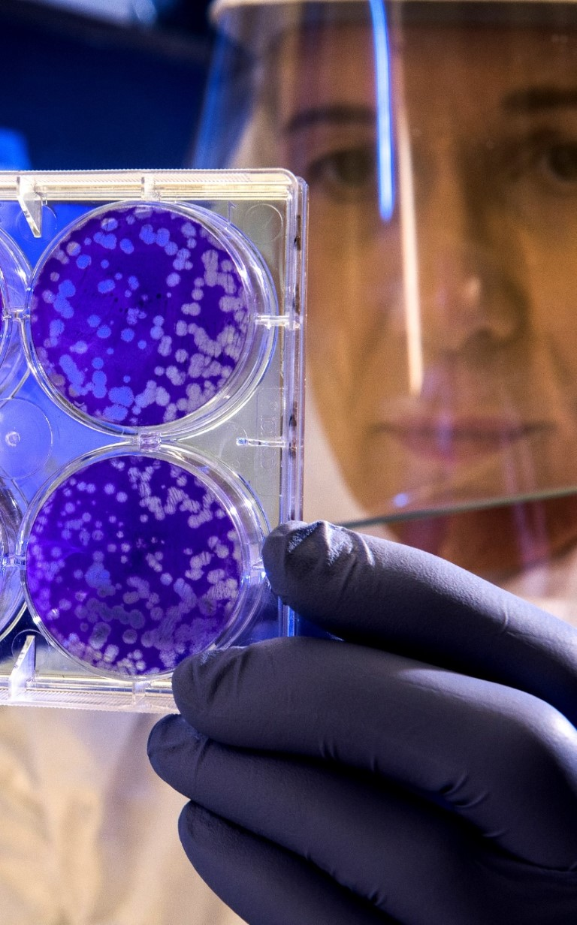
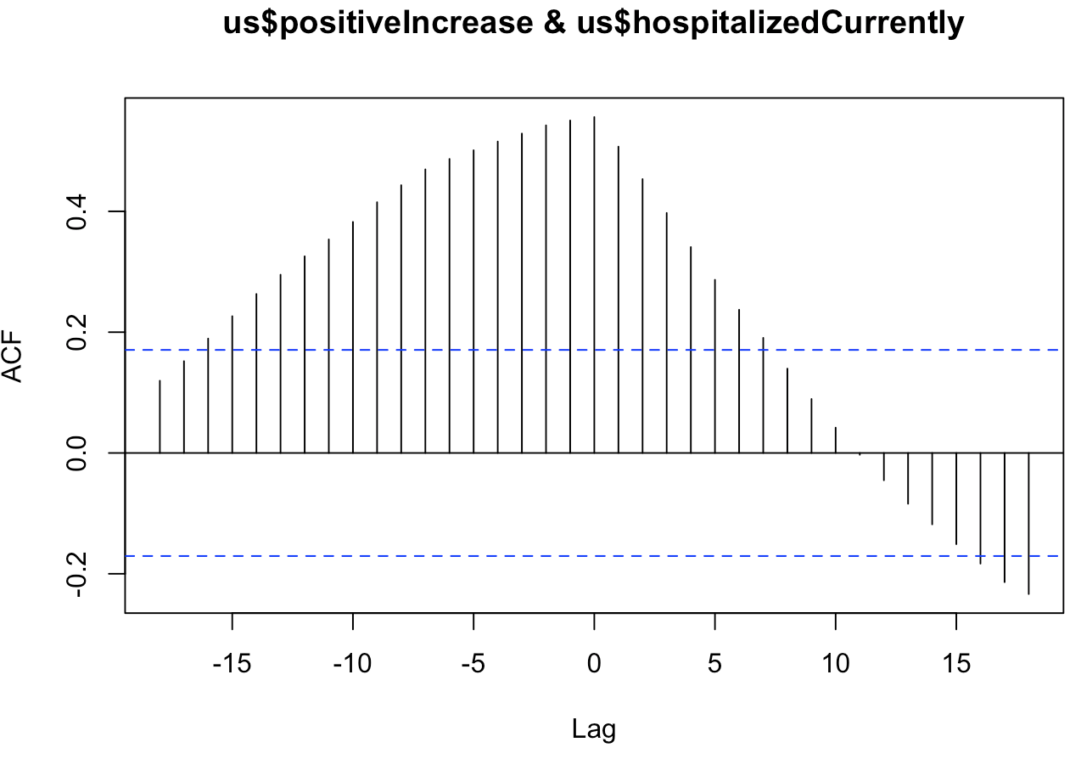
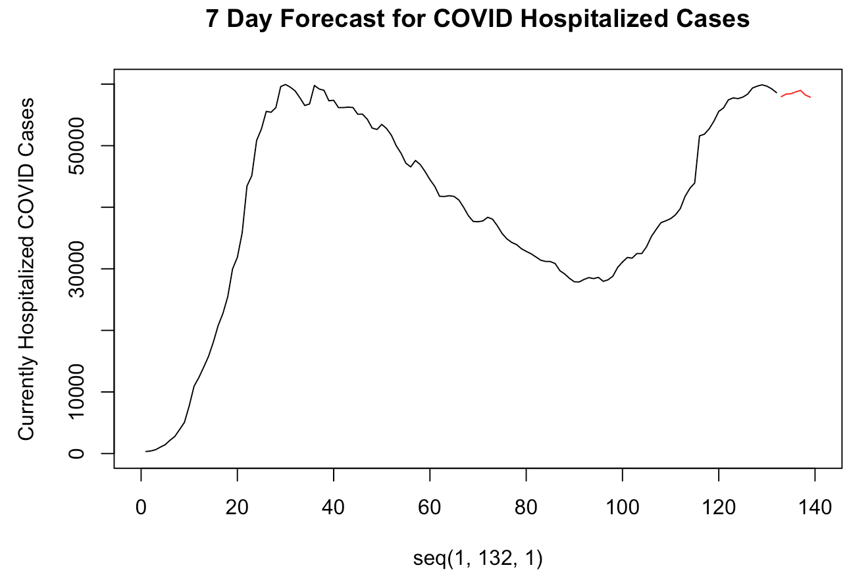
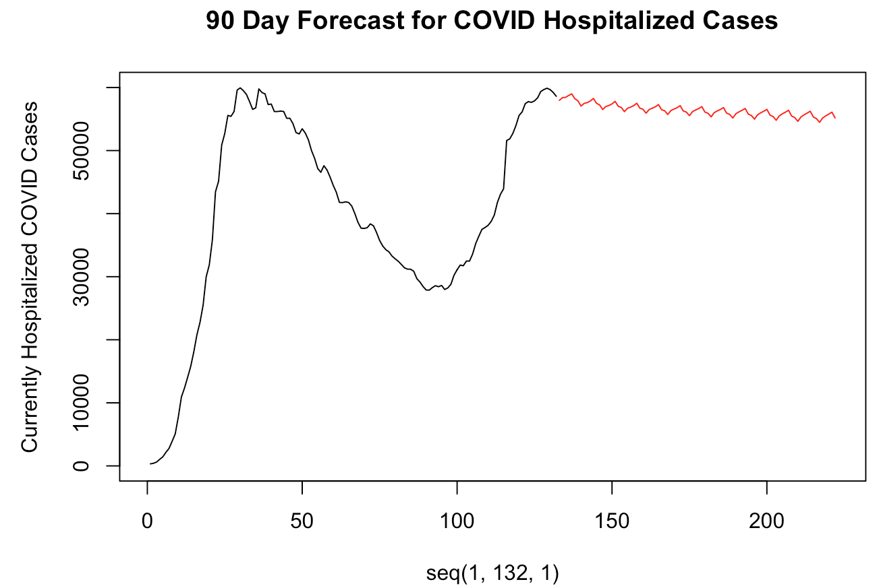

United states
MLR
AIC: 2184.712
7-Day ASE
631,469.8
90-Day ASE
567,209,810
MLR w/ trend
AIC: 2186.678
7-Day ASE
1,449,565
90-Day ASE
2,867,623,021
Notes:
Jaclyn
Time: 20 seconds
When building our MLR models we also reviewed trend and lag to see if those had any significance when predicting COVID hospitalization cases. It turned out there was no relevant correlation between hospitalization cases and new cases. We also surface smaller ASEs and AICs for the model using no trend than the one using trend. This was interesting insight that time was not a significant factor for forecasting in this case.

